Slide 1
Jeopardy Data Analysis
Neha Srivatsa

Slide 2
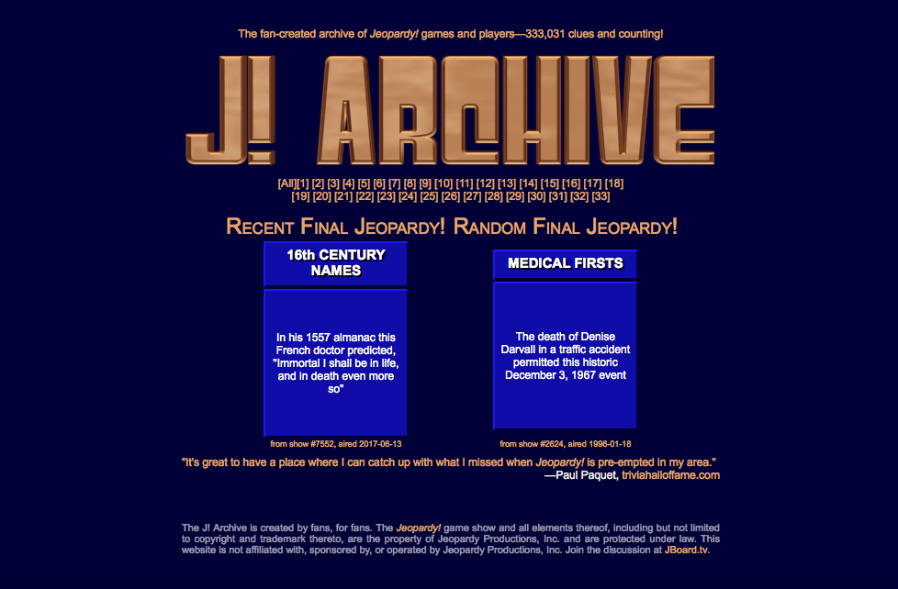
Dataset
Data comes from J! Archive, a fan-created website of Jeopardy questions and answers from 1983—present
Downloaded the website
Parsed the data
Put it in a SQL Database which was read into the final code

Slide 3
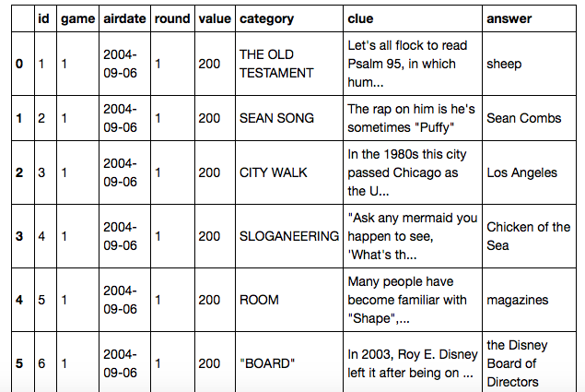
Dataset
Dataset has 330, 563 records and 8 features
The purpose of the analysis was to re-categorize the data based on the clues (questions) provided and then determine which categories are the most common and which are the most valuable

Slide 4
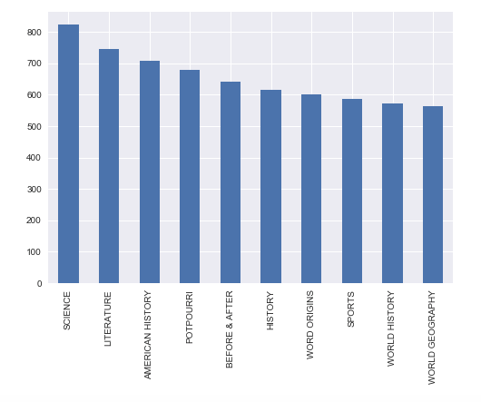
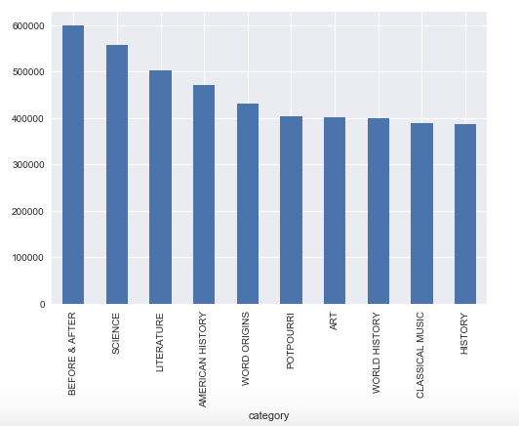
Exploratory Data Analysis
Most Frequent Categories
Most Valuable Categories

Slide 5
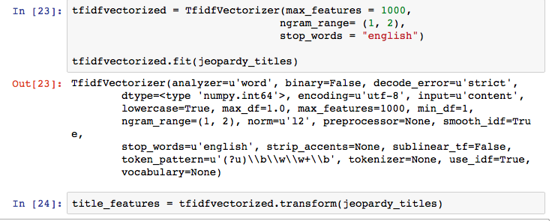
Vectorize text data
Used TF-IDF Vectorizer and CountVectorizer to vectorize the data
Used transform to transform the data into a matrix of the features
Used hstack to horizontally stack the vectors

Slide 6
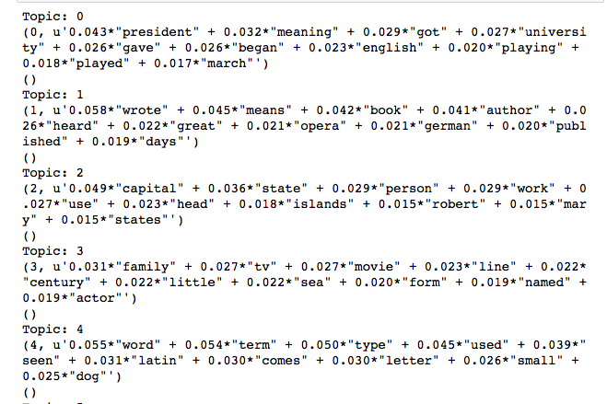
LDA Model
Tried to fit an LDA Model using the first 75000 rows of data
Attempted to adjust the number of topics, but they remained unclear and unidentifiable

Slide 7
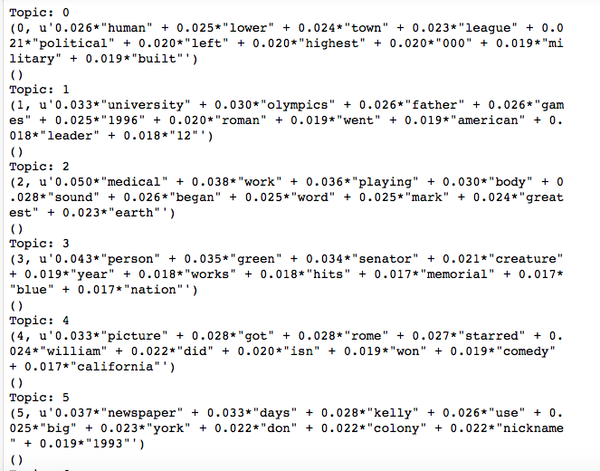
LDA Model
Model with CountVectorized also produced nonsensical clusters

Slide 8
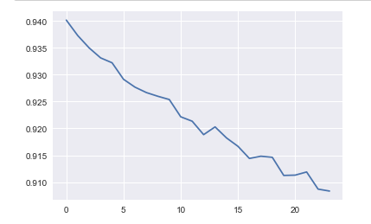
Determining K
Used the “Elbow method” to plot K clusters against the variance
Decided to use 15, but try different values for K to see which ends up with the best model

Slide 9
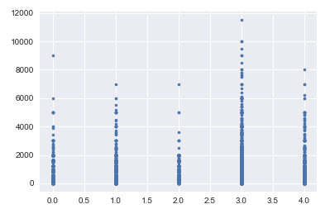
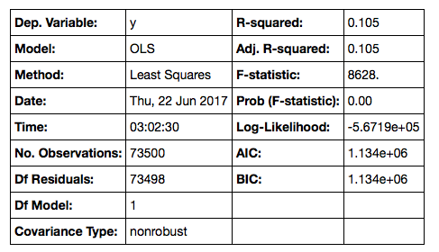
K=5, TFIDF Vectorized

Slide 10
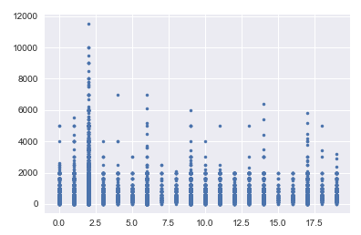
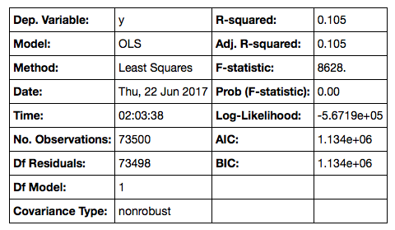
K=20, TFIDF Vectorized

Slide 11
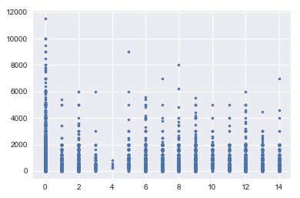
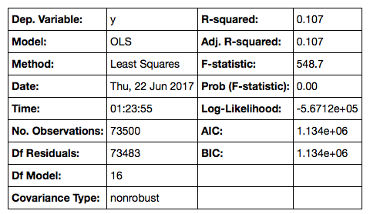
K=15, CountVectorized

Slide 12
Learnings & Future Stepts
Kmeans clustering needs additional refinement to account for uneven sample sizes
Look into other clustering algorithms, such as affinity propagation, that may see more success
Try running a Random Forest model rather than a linear regression, once clusters have been determined
Expand dataset to include right/wrong answers and daily double information

Slide 13
Thank You

